Slide 1

thE GLORY HOTEL
Hotel Reservation System

Slide 2
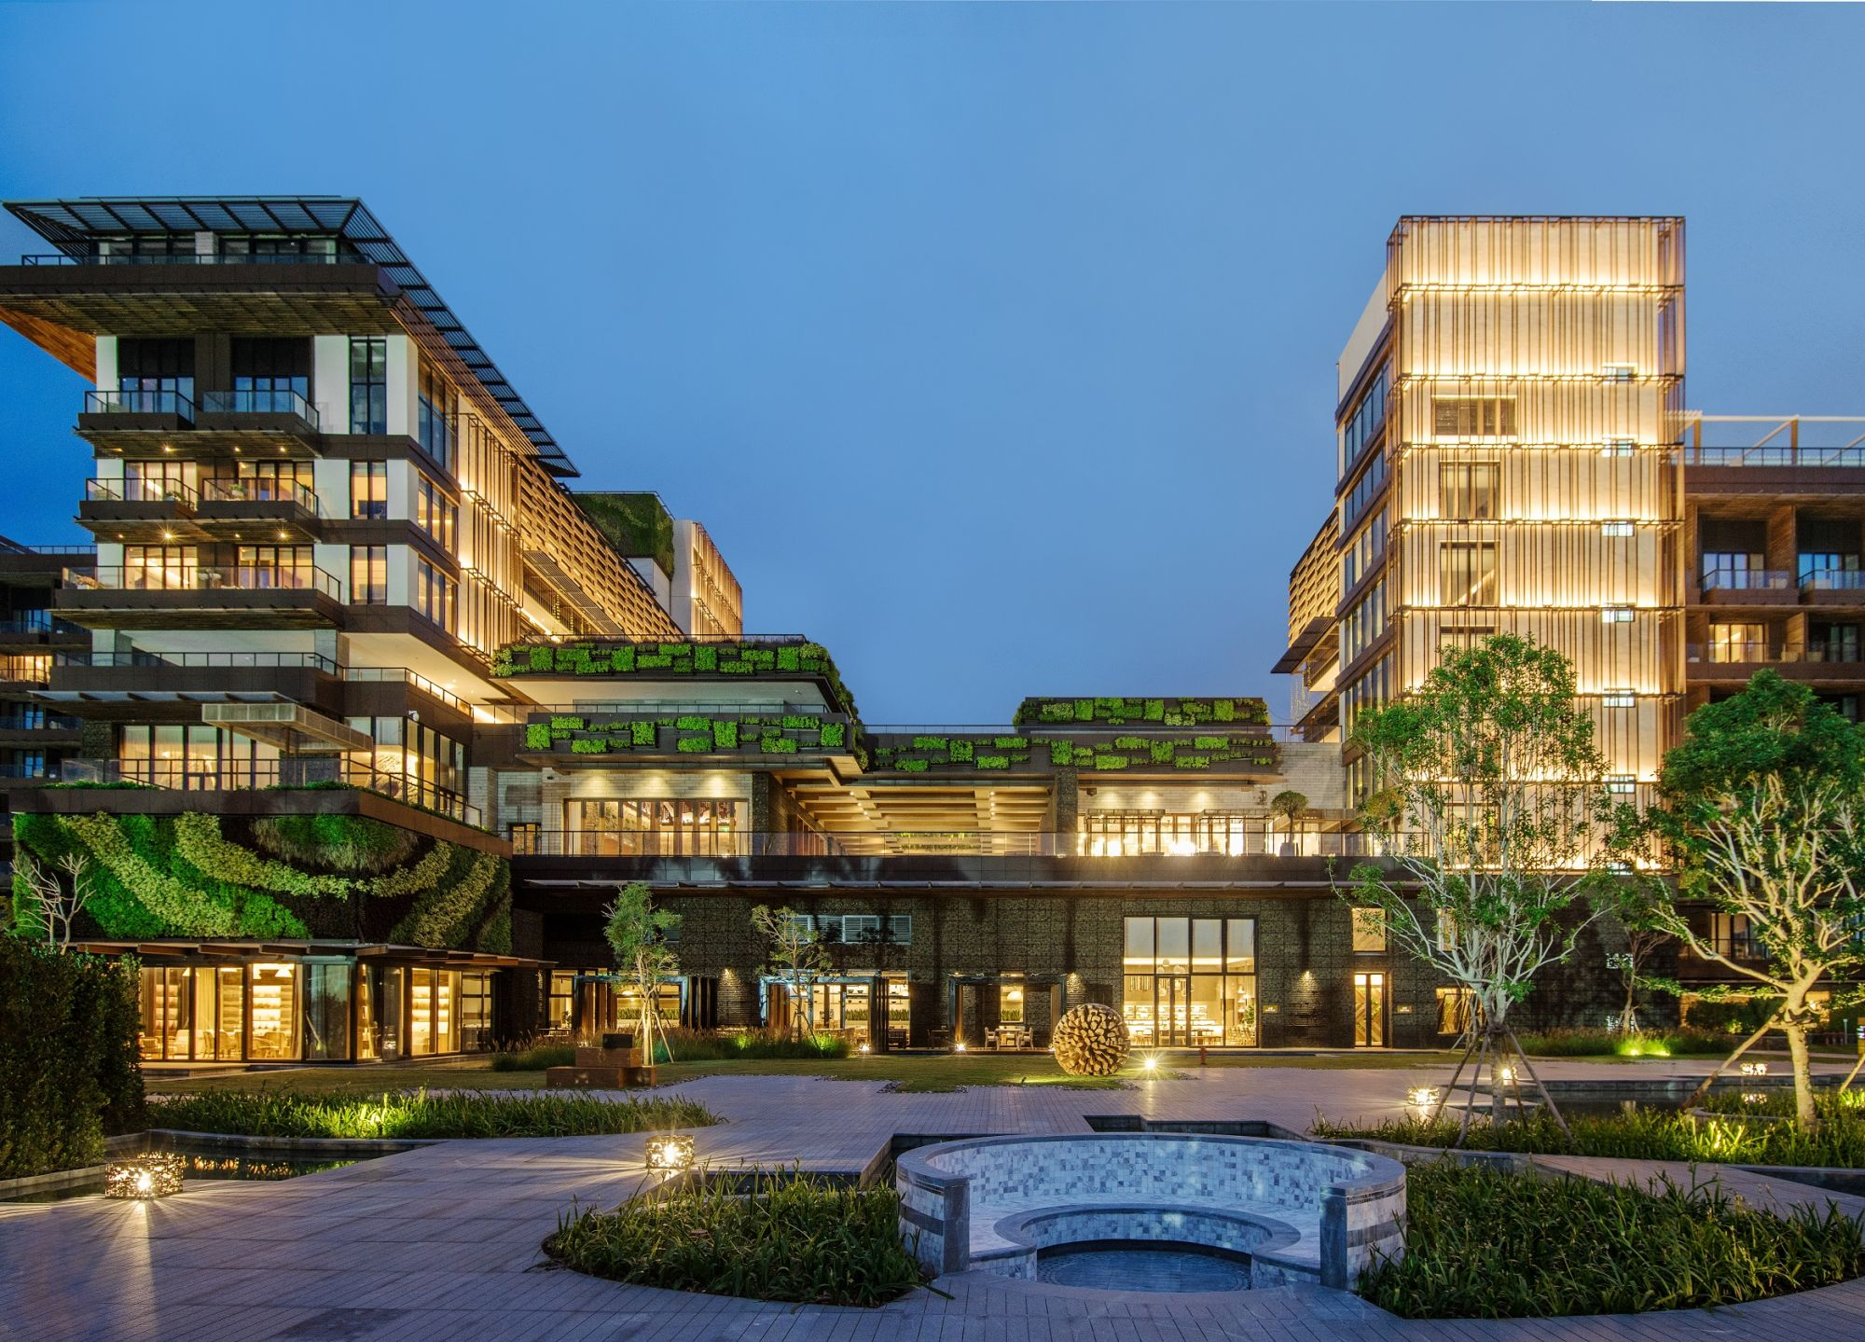
About us
The Glory Hotel is one of the famous tourist hotel located in Badulla. Its history extends up to 50 years. Most tourists visit this place due to several reasons such that its iconic location, and panoramic view of a waterfall from the hotel. Both local and foreign guests reserve rooms, conduct meetings, celebrate parties, and many other functions at the hotel.
Currently, The Glory Hotel is using a manual system to handle the hotel processes. When guests make a reservation, call the reservation details including guest details are recorded in a file. Calculations of bills and inventory items are also done manually. So, we created a hotel management system using java language. They can keep their data long period using this system.
The hotel management system has been developed to override the problems prevailing in the practicing manual system. This system is supported to eliminate, and some cases
reduce the hardships faced by the existing system. Moreover, this system
is designed for the needs of the hotel to carry out operations smoothly and
effectively.
The application is reduced as much as possible to avoid errors while entering
the data. It also provides an error message while entering invalid data. No
formal knowledge is needed for the user to use this system. Every
organization, whether big or small has challenges to overcome and manage
the information of customer details, room details, hotel bills, food bills, etc.
So, this system helps to manage these functions. Hence this hotel
management will ultimately allow management to better manage resources.

Slide 3


GloryHotelProgram
Hotel
The Glory Classes
Availability
NotAvailable
DeluxRoom
LuxuryRoom
OrderFoods
ReadFromFile
WriteToFile

Slide 4
Attributes
Customer Name
Customer Contact
Customer Email
Customer ID
Room Number
Functionalities
Getting details from the customers.
Record the information.
Method
Class 01-
Hotel

Slide 5
Attributes
Customer Name
Customer Contact
Customer Email
Customer ID
Room Number
Functionalities
Getting details from the customers.
Record the information.
Commands
Class 02-
Hotel

Slide 6
Attributes
Room number
Functionalities
Getting room number
Record the information
Methods
Availability();
Class 03-
Availability

Slide 7
Attributes
Amount
Functionalities
Getting customer’s choice.
Methods
getPrice();
Total price
Choice
Choose
Record the information.
Class 04 –
OrderFoods

Slide 8
Attributes
Customer name
Functionalities
Getting details from the customers.
Methods
Customer ID
Customer Contact
Customer Email
Record the information.
Class 05 –
DeluxRoom

Slide 9
Attributes
Customer name
Functionalities
Getting details from the customers.
Methods
Customer ID
Customer Contact
Customer Email
Record the information.
Class 06 –
LuxuryRooms

Slide 10
Attributes
Functionalities
Methods
Class 07 –
NotAvailable

Slide 11
Attributes
Functionalities
Methods
Customer name
Customer Contact
Customer ID
Customer Email
Room Number
Line Count
Customer save to name1
Getting details from the customers.
Record the information.
FileScanner3.clode();
Class 08 –
ReadFromFile

Slide 12
Attributes
Functionalities
Methods
Room Number
Count room
Record the information.
PrintWriter1.close();
Class 09 –
WriteToFile

Slide 13

Object-Oriented Programming Concepts

Slide 14
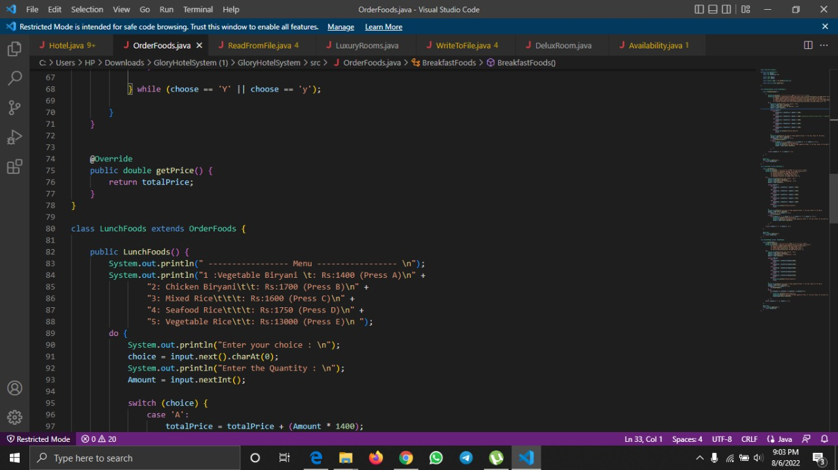
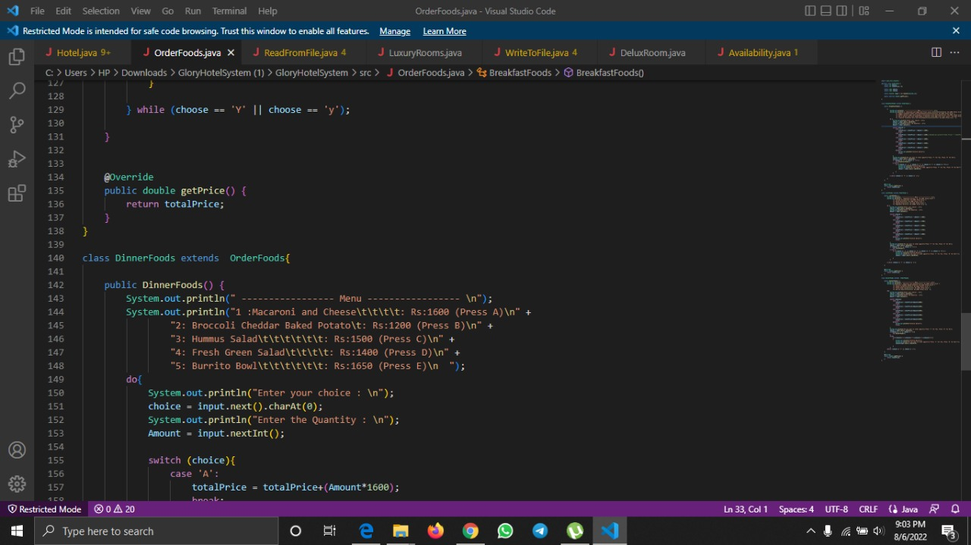
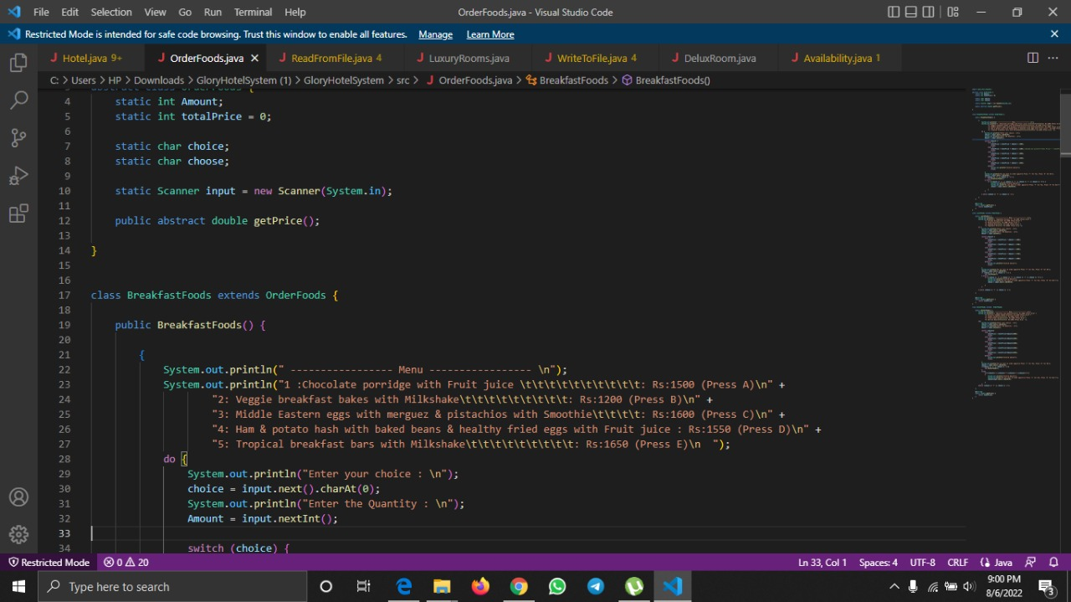
Inheritance
In java it is possible to inherit properties and behaviors from one class to another .
It represents the IS-A relationship (Parent-child relationship) .
Use EXTEND keyword to inherit from a class.
Advantage – Code Reusability

Slide 15
Abstraction
It is a process of hiding certain details and showing only essential information to the user.
Abstraction can be achieved with either abstract classes or interfaces.
Use ABSTRACT keyword .
Advantage – improves maintainability of the application & easiness to use the system.

Slide 16
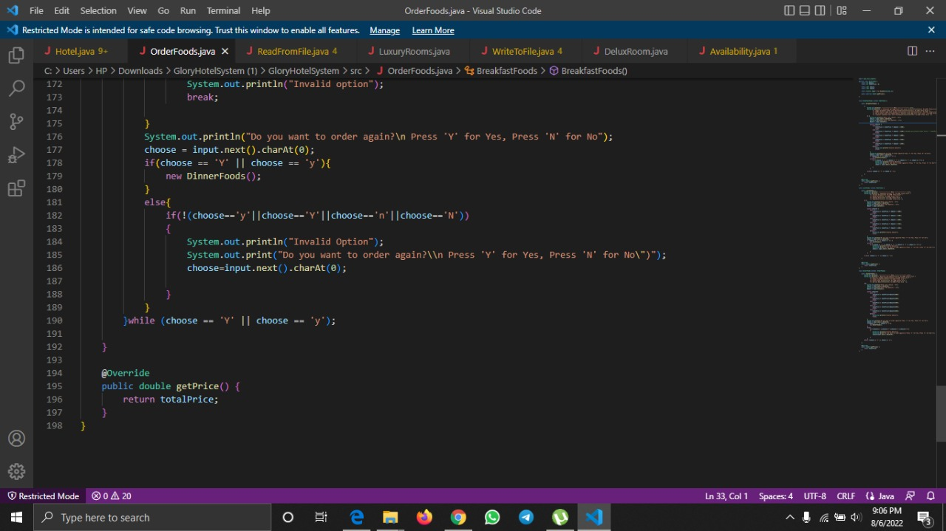
Polymorphism
It is a concept which can perform a single action in different ways .
Two types
Compile-time polymorphism achieved through method over loading.
Runtime polymorphism achieved through method overriding.

Slide 17
Encapsulation
It is known as “sensitive” data hiding from user.
To achieves this, we must
Declare class variables/ attributes as private.
Getter and setter methods provide read-only or write-only access to our class fields.

Slide 18
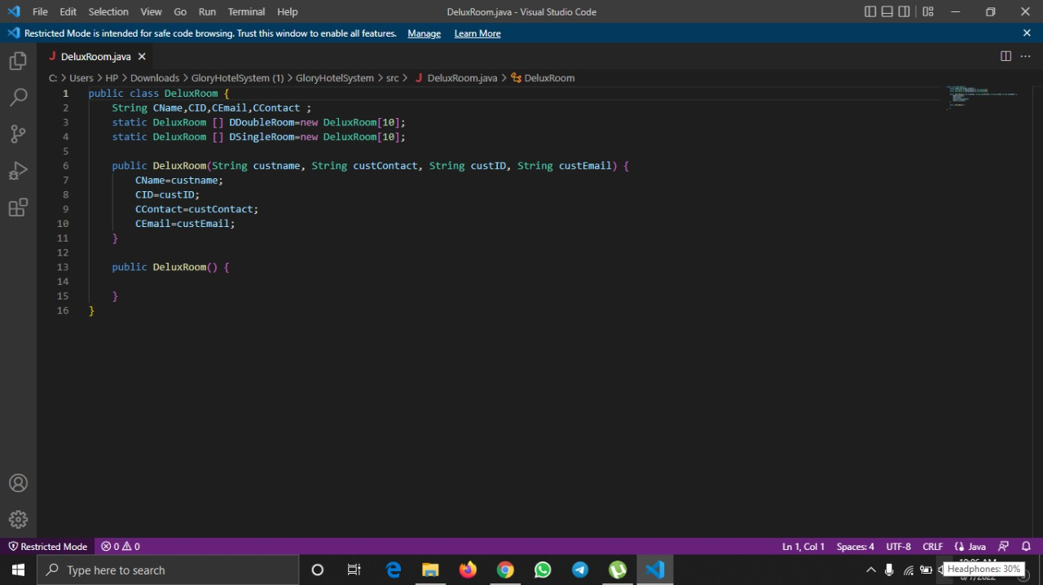
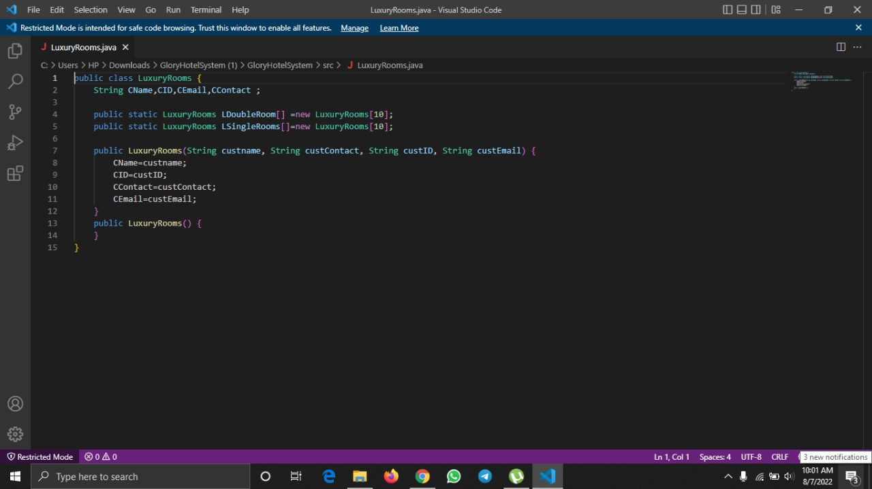
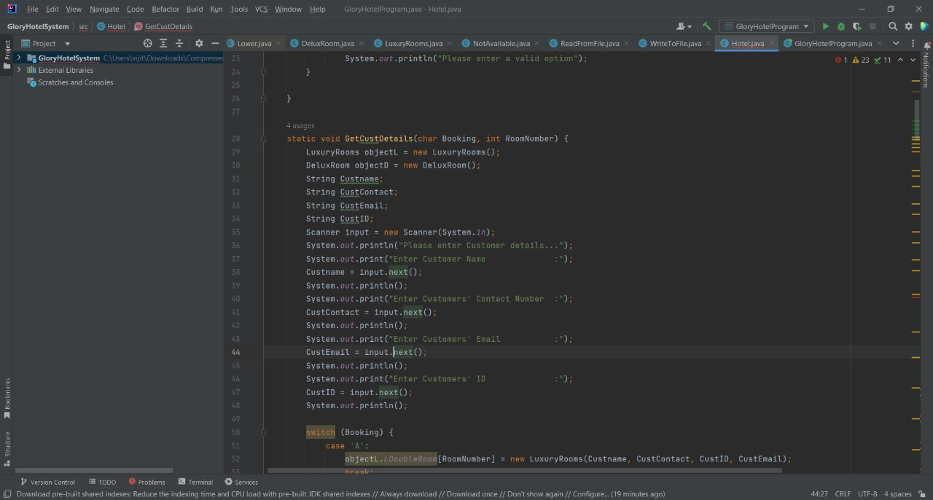
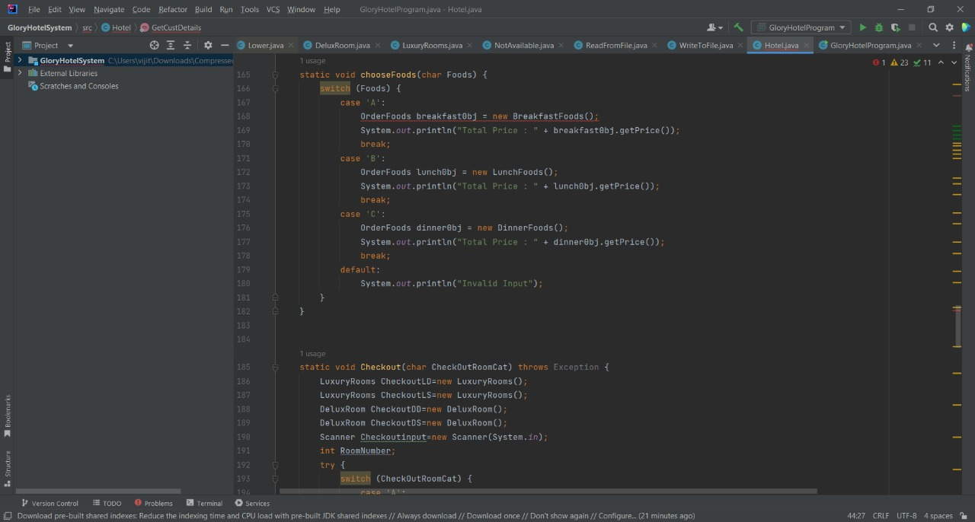
In addition, we used
Classes & objects
Methods & attributes
Static class & static method
Constructors
Access modifiers
as Object-oriented programming concepts .

Slide 19

Short Demonstration about our Program

Slide 20
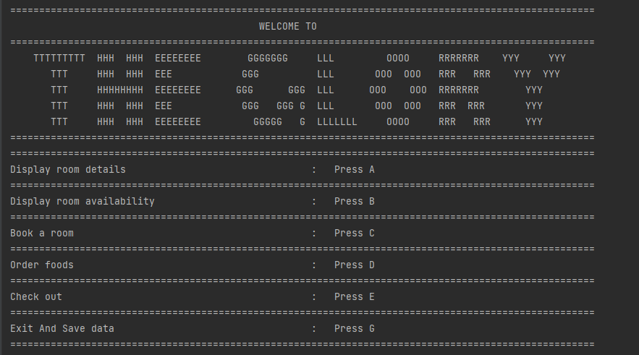


Slide 21
GloryHotelProgram
OrderFoods
Available
WriteToFile
Hotel
DeluxRoom
ReadFromFile
LuxuryRooms
NotAvailable

Slide 22

Login
Validity
Room details
Room availability
Room booking
Order Foods
Getting a room number
Breakfast
Luxury Single Room
Lunch
Luxury Double Room
Dinner
Deluxe Single Room
Deluxe Double Room
Read details
Write details
Checkout
Logout

Slide 23

Modification For The Initial Plan And Reason
There was no way to find the availability of room numbers in the initial report. But later we added the availability part as a class to our project.
We created the main class as GloryHotelProgram by combining all the other classes for easy data maintenance.
There is no opportunity to review the entered customer information in the project proposal report. But In here we can retrieve the customer information when we needed.
In the original report, the rooms for reservation were further developed and two types of rooms were introduced: luxury and Delux.

Slide 24
Challenge 01
We had to find a method for saving the customer information into a text file and read it from a text file.
Solution
We referred many java coding web sites and came up with a solution code.
Referred websites are :
Gopaldave. (2018, 10 16). GeeksforGeeks. Retrieved from Scanner hasNextLine() method in Java with Examples: https://www.geeksforgeeks.org/scanner-hasnextline-method-in-java-with-examples/
Grepper. (n.d.). Retrieved from Read a file line by line assigning to variable using bufferedreader: https://www.codegrepper.com/codeexamples/java/read+a+file+line+by+line+assigning+to+variable+using+bufferedreader
Grepper. (n.d.). Retrieved from Read text file with values in each line java: https://www.codegrepper.com/codeexamples/java/read+text+file+with+values+in+each+line+java
stackoverflow. (2010). Retrieved from How do I create a file and write to it?: https://stackoverflow.com/questions/2885173/how-do-i-create-a-file-and-write-to-it
stackoverflow. (2012, 11). Retrieved from How to remove specific value from string array in java?: https://stackoverflow.com/questions/12812307/how-to-remove-specific-value-from-stringarray-in-java

Slide 25
Challenge 02
Due to the fact that the members of the group live in different areas and the power cuts in those areas at different times of the day, it is difficult for the group to gather at the same time.
Solution
Since there is less power cuts during the night, doing activities during those hours

Slide 26
Challenge 03
Due to the signal drops and difficulty of understanding in online education, we had to face various problems while coding.
Solution
We discuss with each other and refer java coding websites
Referred websites are :
Data, R. (1998). w3schools. Retrieved from https://www.w3schools.com/: https://www.w3schools.com/java/
tutorialspoint. (n.d.). Retrieved from https://www.tutorialspoint.com/index.htm: https://www.tutorialspoint.com/java/index.htm

Slide 27

Teamwork
The group project was successfully completed by giving opportunities to everyone to express their views.
We contributed our ideas with each other. And took the right decisions.
We shared our responsibilities and always tried to get a perfect Hotel Management System as a team.
We helped each other and shared our knowledge about java.

Slide 28

Group members :-
PS/2019/135 – W.M.S.S. Wickramasinghe
PS/2019/126 – R.P.D. Migara
PS/2019/026 – G.M.D. Mahindapala
PS/2019/055 – G.D.D.S. Sarathchandra
PS/2019/199 – K.D.R. Tharushika

Slide 29

YOU’RE SAFE WITH US!!

Slide 30


